Slide 1
Pathways Beyond
Langley Grammar School
2026

Slide 2


Previous Post 18 Options
University
Employment (with or without training)
Gap Year
Globilisation + vocational agenda + rise in tuition fees = more complex landscape
Now potentially 20+ options

Slide 3

Higher Education
Employment
International study
Fully Vocational
Semi-vocational
Academic
Joint/ multi- disciplinary
Two years degrees
HND
Private sector
University/employer
partnership degree
Degree with year in industry
Degree Apprenticeships
Higher
Apprenticeships
Salaried school leaver programme
Job with training
Armed Forces
Self employment
Temping/seasonal/ portfolio work
University overseas
UK university + year
abroad
UK university with overseas campus
Gap Year
UK and/or abroad
Paid and/or unpaid
Volunteering
Travelling
Additional Qualifications-
Art foundation,
TEFL

Slide 4

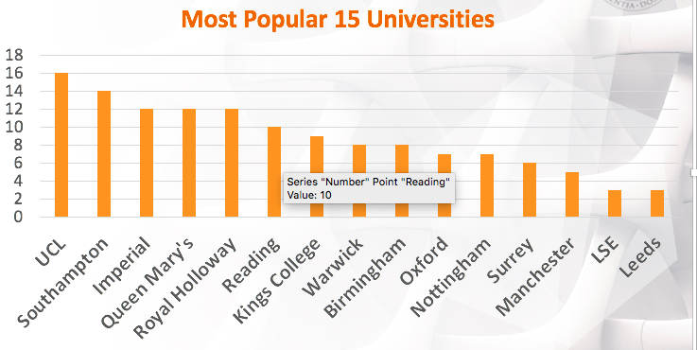
Where are our students going?

Slide 5

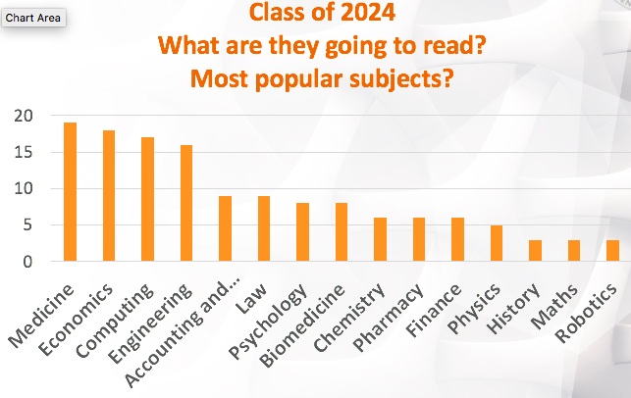
What are our students reading?

Slide 6

Applying to University
Research choice of course & university
Application through UCAS, by a school deadline
Reference written by the school
Consideration by university admissions tutors
Narrow offers to two in April/May- Firm
choice and Insurance choice

Slide 7
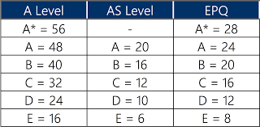
UCAS Points Tariff

Slide 8

Choice of university and course factors to consider
Course content
Teaching methods & contact time- online lectures
Course assessment
Career implications
University reputation (subject specific) Academic requirements (including course specific tests)
University location: distance from home
Campus vs. non-campus Accommodation
Finance: fees; living costs; bursaries …..

Slide 9

Choices
Maximum of five choices
Realism: make sure track record & predicted grades match academic requirements
Include one “back-up” choice with lower requirements
Some choice restrictions:
  Medicine; Dentistry; Veterinary Science: max. 4 choices
  Oxford or Cambridge
Simultaneous consideration
“Invisibility”

Slide 10
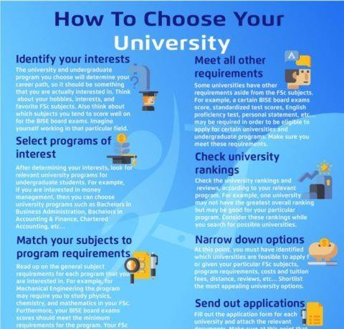

Slide 11






Research: external sources of
Information for students
UCAS website ucas.com- entry requirements
DiscoverUni.co.uk , Whatuni.com, the Uni guide.co.uk, sacu-student.com
University prospectuses, websites and admissions tutors
Institution Open
Days
Taster Courses
www.thecomplete universityguide.co. uk/courses
Subject specific events

Slide 12
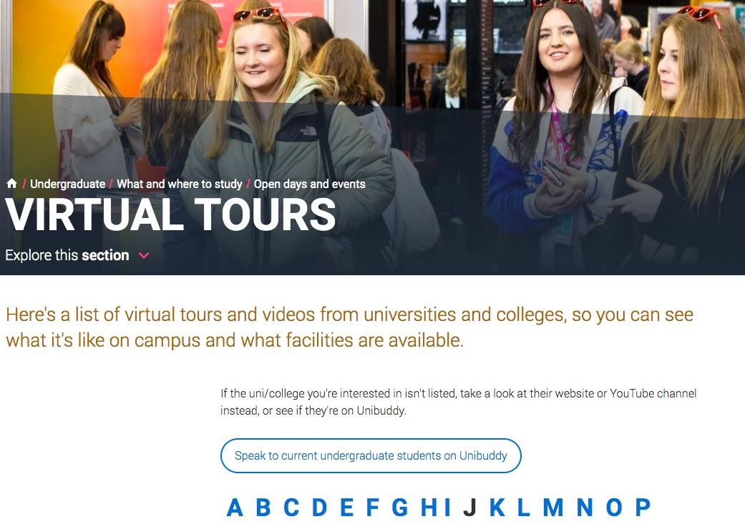
Ucas.com/virtual tours

Slide 13

What type of student
are they looking for?
Does more than the basic demands of subject spec. and has evidence of the passion and enthusiasm for the subject
A self-starter reads on their own initiative
Learns on own initiative/ independently, using the resources on offer
Follows up ideas and leads suggested by school learning with teachers outside lessons.
Has developed particular areas of interest within the subject which are explored with genuine enthusiasm
Has developed new areas of interest outside the specification

Slide 14







Supra- Curricular Activities
Academic Journals
Undergraduate reading lists
Essay competitions
Newspapers and
their websites
Podcasts
Lectures and MOOCs

Slide 15
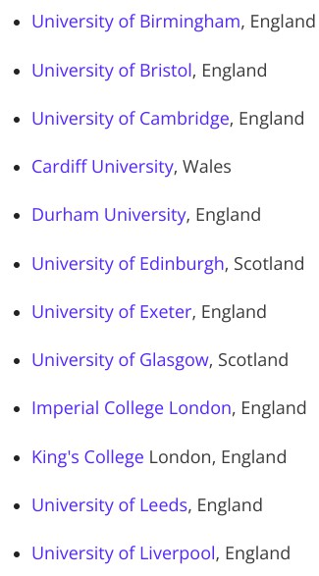
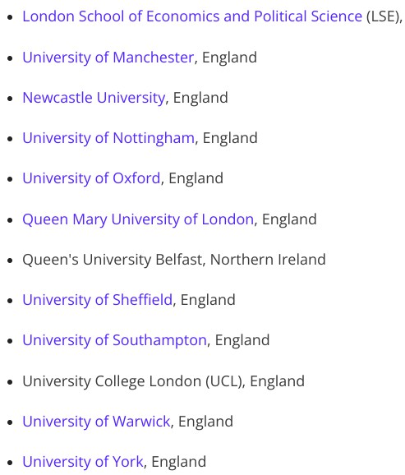
The Russell Group Universities

Slide 16
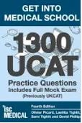

Specialist Admissions Tests
UCAT and LNAT- booked independently and sat at Pearson Centres
Oxford Admissions Tests
Registration deadline, end of September, taken in school
Some Cambridge Tests taken in school some as part of the interview process.
Some other highly competitive universities use online tests.

Slide 17

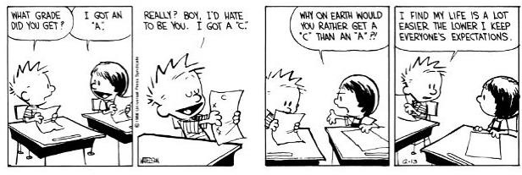
Predicted Grades
Realistically Optimistic
Based on evidence the students have shown under exam conditions across the course
Those intending to be early applicants need to be achieving professional predictions at least A grades at the end of Year 12
At the start of June in Y12 we will issue provisional predicted grades
Two sub level increase on all professional predictions

Slide 18


Personal statement
4,000 characters
Applicant’s opportunity to show why he or she is a good candidate for the course
Focus should be 75% academic
Proof read for spelling, grammar and sense
Lots of guidance in school, one to one guidance by form tutor and perhaps by a relevant subject teacher.
Must be student’s own work:
Beware plagiarism
Beware asking those who are out of date.

Slide 19

Personal Statement
Why do you want to study this course or subject?
How have your qualifications and studies helped you to prepare for this course or subject?
What else have you done to prepare outside of education, and why are these experiences useful?

Slide 20
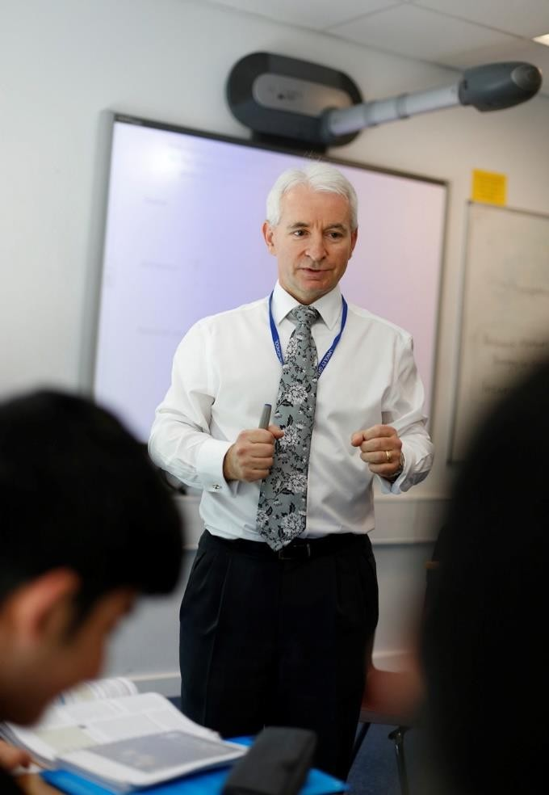
Personal Statement: School Support
Personalised 1:1 support with
your tutor
Sixth Form Leadership Team
Careers Adviser
Academic Mentoring
Specialist subject staff
Specialist workshops for those on the Oxbridge Pathway
Specialist workshops for those applying for Medicine and Dentistry.

Slide 21

School Reference
Written by form tutor with input from all subject teachers
Reviewed by a team of approvers
Positive and honest
Predicted grades- based on
evidence
Review with student to check for errors or omissions (good practice).
Recommendation on your suitability
The process of checking the application and writing the school reference takes approx. 3 weeks from when the student submits their part of the application to us.

Slide 22
Format of the Reference
3 sections:
The School Context
Any extenuating circumstances or support
Other supportive information
The first is compulsory, the second and third section is optional

Slide 23
University Application Timeline
Mid- Sept. School deadline for early applications
Oct. 15th School deadline for “competitive courses”
Start of Nov. School deadline for all other applications
May
Start of UCAS
cycle
15 Oct. 18:00 hrs UCAS early applications deadline (Oxbridge,
Medicine, Dentistry, Veterinary Sci.)
14 Jan 2026 deadline for all other UK university applications

Slide 24
Consideration by universities
Interviews for some courses
Additional tests for some courses
/ universities
Monitor through
TRACK -
Conditional offer (or unsuccessful)
Applicant replies to offers:
One firm acceptance
One insurance acceptance
UCAS Extra available if no offers received
Results Day
Decline other offers
Adjustment and Clearing

Slide 25

Introduction to Unifrog for parents

Slide 26

What is Unifrog?
Unifrog provide a one-stop-shop where students can explore all their post-18 options, as well as providing a range of courses and events that students can sign up to.
All our students undertake Unifrog sessions in their tutor time, so they should be very familiar with how it works.
Based on the interests that students show we send out tailored information to ensure they have as much information as possible on the all the pathways available to them.

Slide 27
The Unifrog tools
Access all tools on Unifrog to learn what options are available, access good quality information, and search for opportunities to support your child.
Quizzes
Exploring pathways
Recording what you’ve done
Searching for opportunities
Drafting application materials
Making applications
Interests profile
Careers library
Activities
UK universities
UK Personal Statement
Post 18 Intentions
Personality profile
Subjects library
Skills
US universities
Classes
Locker
Work environments profile
Know-how library
Interactions
European universities
Subject References
Applications list
MOOC
Oxbridge
CV / Resumé
Skills profile
Webinars
Canadian universities
Writing tool
Read, Watch, Listen
Asian universities
Common App Essay
Australasian universities
US recommenders
MidEast and Africa unis
Notes for Reference writers
Irish universities
Special Opportunities
Events

Slide 28

Careers library
Over 1000 career profiles
Presents information from a range of sources, including local and national information
Includes qualifications and skills needed, interviews with industry professionals and labour market information
Explores progression opportunities and what a working week really looks like

Slide 29
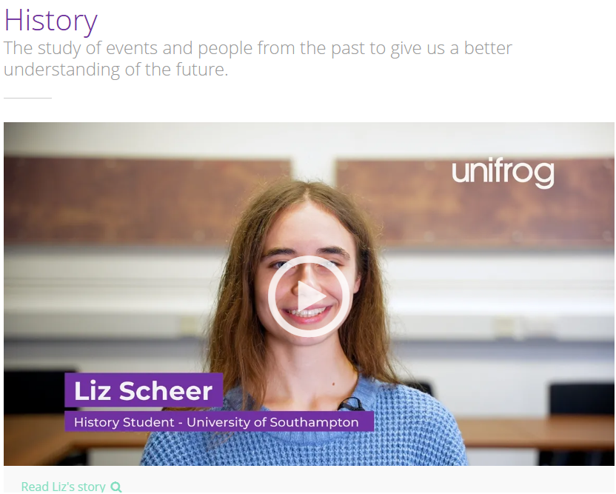
Subjects library
Over 100 university subject profiles
Includes information on:
  A summary of the subject
  Qualification required
  Section on specialist areas
  Recommendations for extra reading/watching/listening
  Explore section that lists all the related Unifrog support

Slide 30
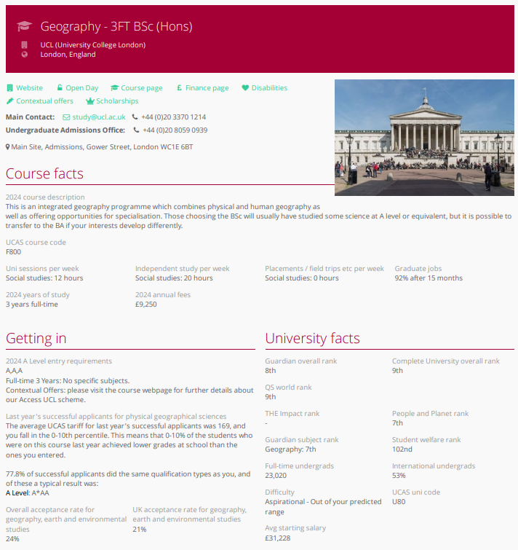
UK Universities
Students can enter subject of interest and projected grades to see all relevant university courses available in the UK
Rank and filter opportunities by factors like hours of lectures, price of accommodation and graduate job rates
Get direct links to university information pages, with impartial information on courses and institutions
Save unlimited shortlists to refer back to later

Slide 31
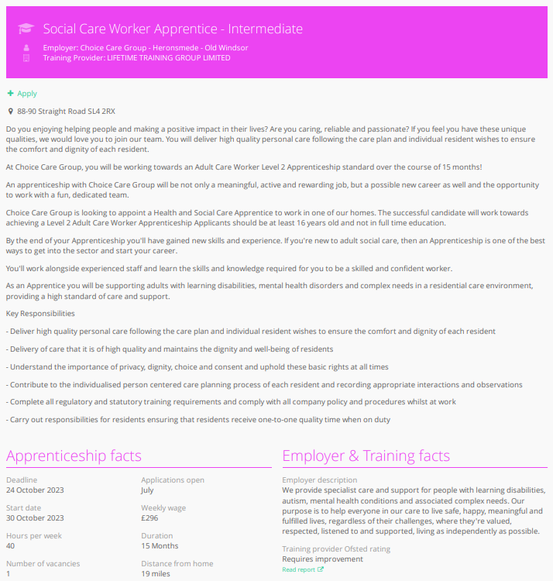
Apprenticeships
Students can find live apprenticeship vacancies
Vacancies are updated daily
Rank and filter opportunities by factors like distance from home, weekly wage and application deadlines
Direct link to the ‘apply’ page
Each apprenticeship vacancy includes practical information about the opportunity, employer and training
Save unlimited shortlists to refer back to later

Slide 32
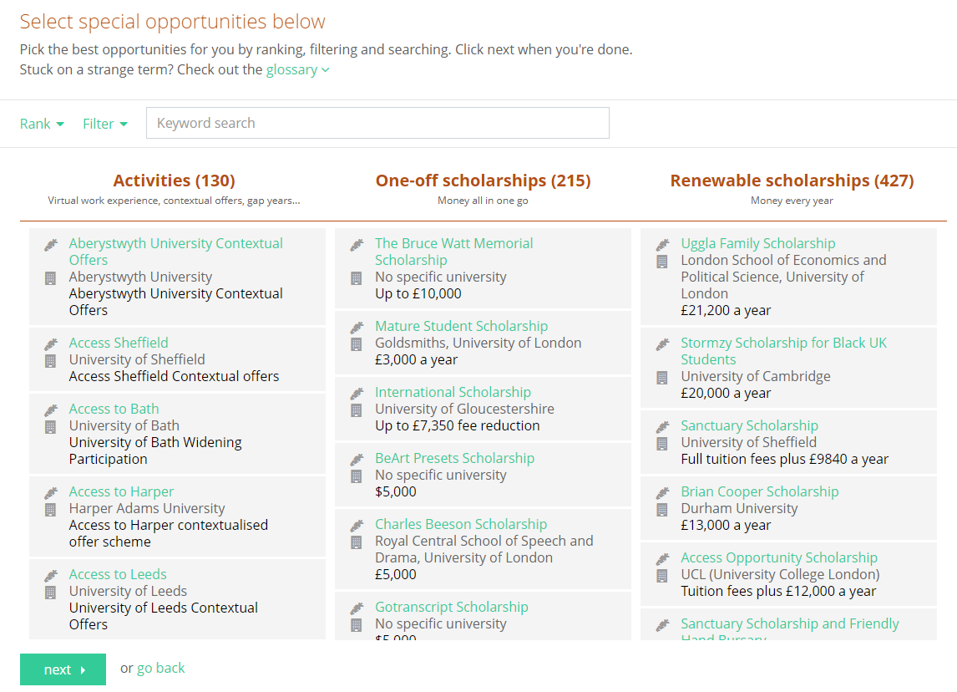
Special Opportunities
Includes £5 million-worth of grants, bursaries, scholarships, contextual offers and extracurricular activities
These can be filtered by circumstances or characteristics, depending on the access requirements of the opportunity
Includes direct links for applying
Unlimited shortlists can be created and referred back to

Slide 33
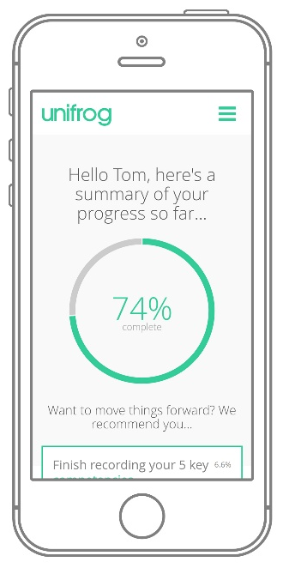
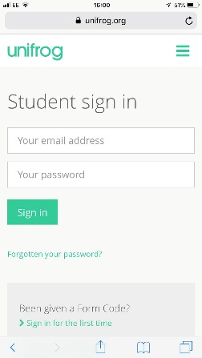
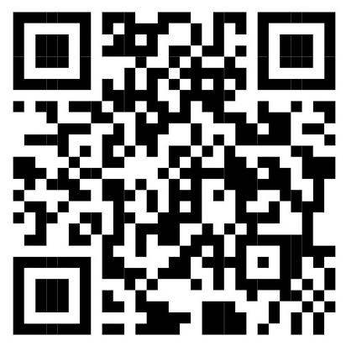
Parents & guardians, how to get signed up!
Scan this QR code or go to www.unifrog.org/student and click ‘Sign in for the first time’
You’ll be asked for some details and a Sign up Code. This is what you need:
LGSSParents
After signing up, log into Unifrog using your email address and password via the student sign-in page!

Slide 34






The Times They Are A-changin'
"Penguin Random House Publishers Has Just Announced It's Scrapping Degree Requirements For Its Jobs”
"Ernst & Young Removes Degree Classification From Entry Criteria As There's 'No Evidence' University Equals Success"

Slide 35

What are Apprenticeships
A REAL JOB WITH A REAL EMPLOYER
PAID A SALARY
QUALIFICATIONS AND EXPERIENCE
CONTRACT OF EMPLOYMENT, HOLIDAY, SICK
SUPPORT FROM TRAINING PROVIDER OR IN SOME CASES UNIVERSITY
3-6 YEARS

Slide 36
Pros & Cons
Pros Cons
No debt (Avg Uni debt 50-60k Miss out on Uni experience
Likely permanent employment Have to start ‘work’ earlier
Likely to be lower grades than Can be very competitive
some Uni’s (AAB)
Can do a L7 Masters even
after completing Uni

Slide 37

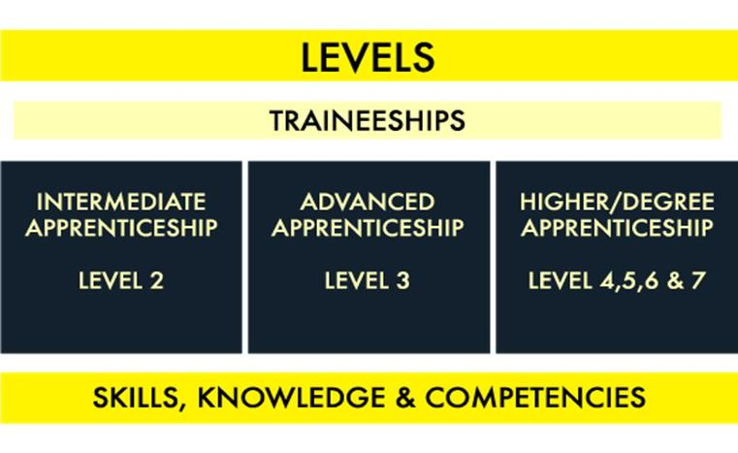
Types of Apprenticeships

Slide 38

Current Higher/Degree Apprenticeship Vacancies
Aerospace Engineering (Airbus / BAE Systems)
Automotive Engineering (BMW Group / Rolls Royce)
Business and Administration (Pearson Plc / DHL)
Construction (BAM / Laing O’ Rourke)
Digital (BT / Fujitsu / Network Rail)
Engineering and Manufacturing (BAE Systems / Arup)
Finance (Natwest / UBS / Lloyds)
Legal (DWF Law LLP)
Nuclear (Sellafield)
Surveying (AECOM)

Slide 39


Degree Apprenticeships at Russell Group
Universities
Queen Mary University of London
Chartered Manager
Software Engineer
University of Exeter
Civil Engineering
Applied Finance (J.P. Morgan)
University of Birmingham
Computer Science with Digital Technology
University of Warwick
Engineering (Dyson)
Social Work

Slide 40


Slide 41

What Are Employers Looking For?
Flexibility and adaptability
Tact and diplomacy
The ability to work under pressure and to tight deadlines
The ability to be proactive and work on your own initiative
Honesty and reliability
Attention to detail
Discretion / understanding of confidentiality issues
Remain calm under pressure and to think quickly in a crisis
Adapt quickly to change

Slide 42


CTM Pathway
Mentoring
Employability Insight Days
Work Experience Opportunities Networking
Website
Tailored notifications to interests
Pathwayctm.com

Slide 43



Oxbridge Pathway
Visit to Brasenose College Tailored workshops on personal statements
Planned sessions by an Oxford Admissions tutors
Specialist preparation sessions on some admissions tests
Interview practice
Guidance on specialist reading 1:1 mentoring

Slide 44



Medicine/Dentistry/
Veterinary Science Pathway
Discussion sessions on medical issues
Tutoring through the stages of the specialist application
Tailored workshops on personal
statements
Specialist preparation sessions ethics questions/ MMI interviews
Panel Interview practice Guidance on specialist reading

Slide 45

School support
Careers section of school website
Careers Interviews
Guidance and Advice- 1:1 support with personal statements with tutors
UCAS and Personal Statement Resources shared folder to students
University section of student handbook
Unifrog
CTM Pathways- apprenticeships
Specialist workshops on personal statements and interviews
What Next ? University and Apprenticeship Fair
Careers Conferences- Passport for
Life and Towards the Future

Slide 46
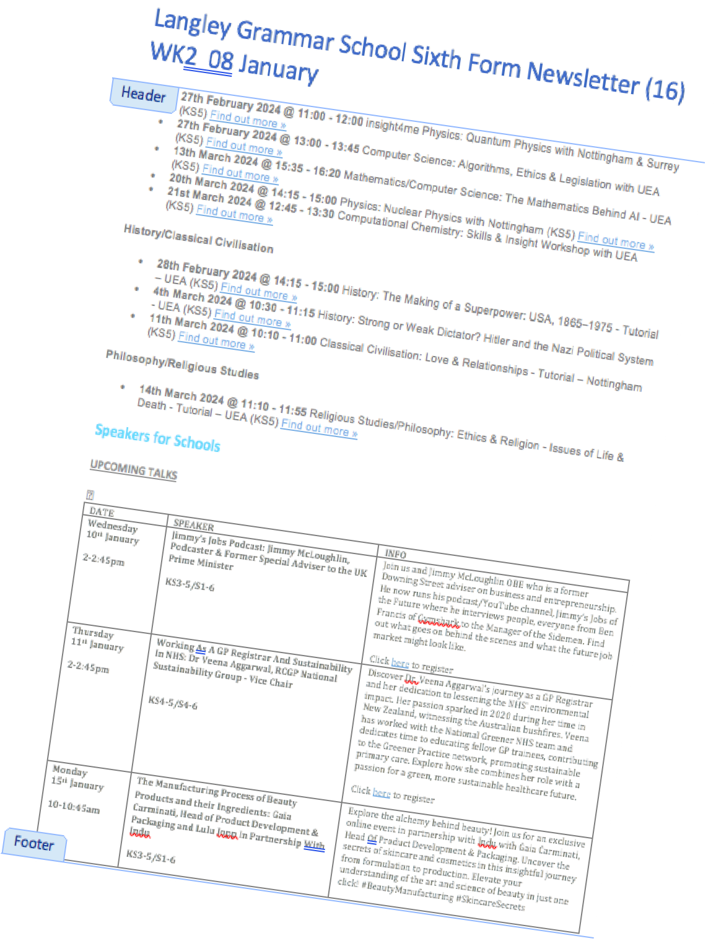
How can you help as parents?
Emotionally support by understanding the process
Talk to students who have been through the process or who are studying at the university
Top universities are looking for well-rounded, independent learners who have the evidence of their passion in their subject
Help them to research and talk to admissions tutors- aspirational offers
Take them to visit- doesn’t have
to be an open day (3 days?)

Slide 47

Resources for Parents
UCAS Parent Guide https://www.ucas.com/file/715336/down load?token=iNdDS9Yl
Inspiring choices- Parents/Carers
https://www.inspiring- choices.co.uk/support/resources-for- parentscarers/
The Complete University Guide-
Application Advice for Parents
https://www.thecompleteuniversityguide. co.uk/student-advice/applying-to- uni/application-advice-for-parents

Slide 48
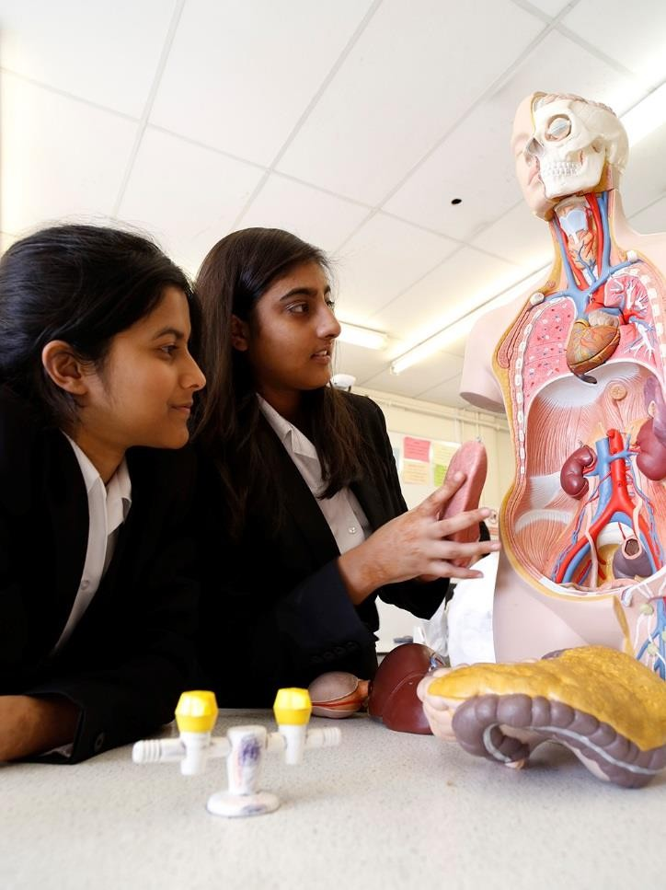
What should students be doing now?
Research
Reflect on super- curricular activities
Work experience v experience of work (if they want to study a vocational degree)
Reading beyond the
specification
Focus on this year’s
studies

Slide 49

Questions
Name | Langley Grammar School | June 2024

